Slide 1
Chapter 12
Working Capital Management

Slide 2
Objectives
After studying this topic you should be able to:
Understand the importance of working capital to the business
Evaluate the different working capital policies that can be adapted by a firm
Understand what the key components of working capital are
Consider the working capital requirements of a firm with respect to inventory, accounts receivable, cash and accounts payable
Establish sound policies for the efficient management and control of the key component elements

Slide 3
The Working Capital Cycle
Produce products/ services
Sell products/ services
Customers owes money
Cash from customers
Buy inventory

Slide 4
Measuring Working Capital
The working capital of a business can be easily measured by looking at its statement of financial position. It reflects the current assets minus the current liabilities.
Money expected to flow in – money expected to flow out
Working capital management is a matter of ensuring sufficient liquid resources (cash) are maintained this involves achieving a balance between the requirement to minimise the risk of insolvency (running out of cash) and the requirement to maximise the return on assets (be efficient with the cash). It is therefore important from two aspects liquidity and profitability.

Slide 5
Working capital Policy
The working capital policy is a function of two decisions within the organisation:
The Investment decision – what do I need to buy?
The Finance decision – where can I access the money?

Slide 6
Matching Policy
Fluctuating Current Assets
Short-Term Financing
Permanent Current Assets
Investment £000
Long-Term Financing
Non-Current Assets
Time

Slide 7
Conservative Policy
Fluctuating Current Assets
Short-Term Financing
Permanent Current Assets
Investment £000
Long-Term Financing
Non-Current Assets
Time

Slide 8
Aggressive Policy
Fluctuating Current Assets
Short-Term Financing
Permanent Current Assets
Investment £000
Long-Term Financing
Non-Current Assets
Time

Slide 9
Operational V Financial Imperatives
Operational perspective | Financial perspective
The restaurant manager wants to ensure there is sufficient stock (inventory) in place to be able always offer the full menu and not run out of individual food items. | The accountant wants money ‘tied up’ in Inventory to be kept to a minimum, so the resource is available to ‘work’ within the business.
In order to gain contracts for an event or conference the event’s manager is willing to agree trade credit terms with the customer. | The accountant wants to ensure the customer is ‘credit worthy’ and if credit terms are allowed there is a high chance they will be able to pay in the future and on time.
The operations manager wants to have a good working relationship with their suppliers, so the suppliers will work with them when they need urgent extra supplies. | Financially, paying suppliers as late as possible (without incurring penalties) makes financial sense.

Slide 10
Working Capital Characteristics of Different Businesses
Most businesses will have different working capital requirements because of three main areas:
Holding inventory
Time allowed for customers to pay
Time taken to pay suppliers

Slide 11
Management of Inventory
Inventory Costs can be classified as:
Holding Costs
Procurement Costs
Shortage Costs
Cost of Inventory Itself

Slide 12
Inventory Control Policy
An inventory control policy should reflect the following four criteria:
Keep total costs down (ideally to a minimum).
Provide satisfactory service levels to customers.
Ensure smooth-running production systems.
Be able to withstand fluctuations in business conditions, e.g. changes in customer demand, prices, availability of raw materials, etc.

Slide 13
Inventory Control Formulae
    Reorder level
Maximum usage x maximum lead time
    Minimum level
reorder level - (average usage x average lead time)
    Maximum level
reorder level + reorder quantity - (minimum usage x minimum
lead time)
    Average inventory
safety inventory + 1/2 reorder quantity

Slide 14
Economic Order Quantity (EOQ)
Where : D = demand
C_{o} = cost of one order
C_{h} = holding cost per inventory unit per annum
Q = quantity to be ordered

Slide 15
Total Cost
HOLDING COST + REORDERING COST
Holding = Q x C_{h} Reordering = D x C_{o}
2 Q

Slide 16
Example
Perfecto Pasta uses tomato puree on a regular basis throughout the year. The annual demand of the puree is 5400 kg and the cost of holding 1kg in terms of shelf and fridge space is £0.75. Records show that it costs £2.50 to place and process an order.

Slide 17

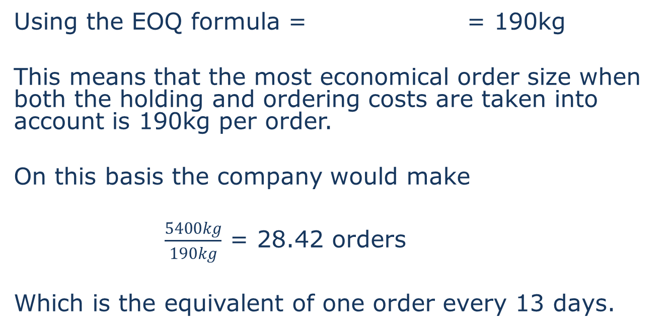
Answer
Using the EOQ formula = = 190kg
This means that the most economical order size when both the holding and ordering costs are taken into account is 190kg per order.
On this basis the company would make
$\frac{5400kg}{190kg}$ = 28.42 orders
Which is the equivalent of one order every 13 days.

Slide 18
Graph showing EOQ

Slide 19
EOQ and discounts
The EOQ formula may need to be modified if bulk discounts are available. It is necessary to minimise the total of:
total purchase costs
ordering costs
inventory holding costs
The total cost will be minimised at the pre discount EOQ level so that the discount is not worthwhile or at the minimum order size necessary to earn the discount.

Slide 20
Example (1)
Perfecto Pasta regularly buys Prosecco from a local wholesaler. The cost of making an order has been estimated at £3.00 and the cost of holding a bottle in stock is 1.50, the annual purchase from the wholesaler has been 19,600 bottles at a price of £7 each. On this basis the economic order quantity for Perfecto has been 280 bottles per order. The wholesaler has now offered Perfecto a deal where if they order in batches 400 they can have a 1% discount per bottle.
Is it beneficial for Perfecto to take the order and hold a greater number of units?

Slide 21
Example (2)
There are three elements to the cost: £
Purchase price £7 x 19600 bottles 137,200
Holding cost 280/2 x 1.50 210
Ordering cost 19600/280 x 3 210
Total cost of ordering 280 bottles per order 137,620
New offer buy 400 bottles per order
Purchase price £7x 0.99 x 19600 bottles 135,828
Holding cost 400/2 x 1.50 300
Ordering cost 19600/400 x 3 147
Total cost of ordering 280 bottles per order 136,275
In this case it is better for Perfecto to accept the offer from the supplier as the saving on the purchase price outweighs additional holding cost.

Slide 22
Managing Accounts Receivable
Businesses of most types need to allow credit to achieve satisfactory sales. Allowing credit however, results in:
An interest cost of funds tied up in giving credit to customers
Possibility of bad debts (this occurs when customers do not pay the amount they owe)
A balance has to be found between sales volume, credit allowed, interest costs and bad debts.

Slide 23
The Credit Cycle
The stages in the credit cycle are as follows:
Receipt of customer order;
Credit screening and agreement of terms;
Goods dispatched or service provided with delivery note;
Invoice raised stating credit terms;
Debt collection procedures;
Receipt of cash.

Slide 24
Credit Control
Management when formulating a credit control policy must consider the following factors:
Cost of managing accounts receivable
Procedures for controlling credit
Capital required to finance credit
Credit terms and allowing discount for prompt payment
Creditworthiness of customers

Slide 25
Cost of managing accounts receivable
Accounts receivable management as previously mentioned is about balancing the benefit of extending credit against the costs. The costs to be considered are:
The opportunity cost of capital
Cost of bad debts
Cost of extending settlement discounts
Administration costs of managing the credit control function.

Slide 26
Assessing Creditworthiness
Gather references at least two, one of which should be from the bank
Check credit ratings
Set credit limits and payment terms and review them regularly
Review the files of clients
Use internal sources such as reports from salespeople
Utilise external information e.g. government, press
Analyse their financial statements
Visit the organisation

Slide 27
Collecting debts (1)
There are two stages in collecting debts the first involves efficient and prompt procedures for dealing with paperwork:
Customers must be fully aware of the credit terms
Invoices should be sent out immediately after delivery
Checks should be carried out to ensure that invoices are accurate
The investigation of any queries or complaints should be carried out promptly
Monthly statements should be sent out early enough for them to be included in the customer’s monthly settlement of bills

Slide 28
Collecting Debts (2)
The second involves procedures for pursuing overdue debts:
Reminders on final demands
Chasing by telephone
Making personal approaches
Stopping credit
Transfer of debt to specialist collection team
Instituting legal action
Transfer of debt to external debt collection agency

Slide 29
Age Analysis of Accounts Receivable
Homely Hotels Ltd.
Age analysis of accounts receivable as at 31 March 2012
Account number | Customer name | Balance | Up to 30 days | 31-60 days | 61-90 days | Over 90 days
C005 | Coolerage Ltd | 175.40 | 120.15 | 55.25 | 0.00 | 0.00
J002 | Jenkins Ltd | 679.30 | 486.00 | 0.00 | 193.30 | 0.00
M008 | Maple Plc | 243.90 | 243.90 | 0.00 | 0.00 | 0.00
S012 | Stanton Ltd | 1,346.70 | 0.00 | 0.00 | 419.40 | 927.30
T001 | Trent Ltd | 396.53 _______ | 264.80 _______ | 131.73 _______ | 0.00 _______ | 0.00 _______
Totals |  | 2,841.83 ======= | 1,114.85 ======= | 186.98 ======= | 612.70 ======= | 927.30 =======
Percentage |  | 100% | 39% | 6.6% | 21.6% | 32.6%

Slide 30
  External Ways of Managing Accounts Receivable
Credit Insurance
Factoring
Invoice Discounting

Slide 31
Managing Accounts payable
The management of trade credit involves:
Seeking satisfactory trade credit from suppliers
Seeking credit extension during periods of cash shortage
Maintaining good relations with suppliers

Slide 32
Management of Cash
This relates to two areas in many businesses:
How much cash should be kept in the bank (profitability)
How to deal with cash flow problems (liquidity)

Slide 33
Cash Flow Forecast
This document is an essential one in any business; it records the expected inflows of cash and expected outflows, enabling a company to predict its cash requirements. Should additional finance be required the needs can be analysed and resources found efficiently and effectively in advance. Should surplus cash be available this can be invested in order to increase the profitability of the firm.
The accuracy of this document rests on the ability to make realistic predictions of the movement of cash, particularly the forecast sales. Some businesses will undertake risk analysis by producing best and worst case scenarios of the cash flow.

Slide 34
Example
Glastowood festival is a major event put on each year in August. The festival organisers produce a cash flow forecast each year on a quarterly basis to monitor the cash inflow and outflow associated with the festival.
The following is the cash flow forecast for the festival due to take place next August.

Slide 35
Answer
Cash flow forecast for Glastowood Festival
 | Quarter 1 | Quarter 2 | Quarter 3 | Quarter 4
 | Jan - March | April - June | July - Sept | Oct - Dec
 | £ | £ | £ | £
Receipts
Ticket sales | 400,000 | 1,500,000 | 500,000 | 0
Franchise outlets |  |  | 347,000 | 98,000
merchandise |  | 37,000 | 460,000 | 32,000
Total Receipts | 400,000 | 1,537,000 | 1,307,000 | 130,000
Payments
Band bookings | 85,000 | 378,000 | 124,000 | 0
Venue hire | 60,000 | 0 | 0 | 2,000
Marquee hire | 45,000 | 45,000 | 45,000 | 0
Staffing | 200,000 | 200,000 | 400,000 | 200,000
Overheads | 95,000 | 136,000 | 297,000 | 72,000
Food and beverage inventory | 79,000 | 258,000 | 596,000 | 0
Total Payments | 564,000 | 1,017,000 | 1,462,000 | 274,000
Opening cash balance | 5,000 | -159,000 | 361,000 | 206,000
Net cash flow | -164,000 | 520,000 | -155,000 | -144,000
Closing cash balance | -159,000 | 361,000 | 206,000 | 62,000

Slide 36
The organisers decided to offer a 10% discount for early purchase and half of those buying in quarter 2 take up the offer
Cash flow forecast for Glastowood Festival
 | Quarter 1 | Quarter 2 | Quarter 3 | Quarter 4
 | Jan - March | April - June | July - Sept | Oct - Dec
 | £ | £ | £ | £
Receipts
Ticket sales | 1,110,000 | 750,000 | 500,000 | 0
Franchise outlets |  |  | 347,000 | 98,000
merchandise |  | 37,000 | 460,000 | 32,000
Total Receipts | 1,110,000 | 787,000 | 1,307,000 | 130,000
Payments
Band bookings | 85,000 | 378,000 | 124,000 | 0
Venue hire | 60,000 | 0 | 0 | 2,000
Marquee hire | 45,000 | 45,000 | 45,000 | 0
Staffing | 200,000 | 200,000 | 400,000 | 200,000
Overheads | 95,000 | 136,000 | 297,000 | 72,000
Food and beverage inventory | 79,000 | 258,000 | 596,000 | 0
Total Payments | 564,000 | 1,017,000 | 1,462,000 | 274,000
Opening cash balance | 5,000 | 551,000 | 321,000 | 166,000
Net cash flow | 546,000 | -230,000 | -155,000 | -144,000
Closing cash balance | 551,000 | 321,000 | 166,000 | 22,000

Slide 37
The organisers secure a headline act early which would also encourage early sales
Cash flow forecast for Glastowood Festival
 | Quarter 1 | Quarter 2 | Quarter 3 | Quarter 4
 | Jan - March | April - June | July - Sept | Oct - Dec
 | £ | £ | £ | £
Receipts
Ticket sales | 900,000 | 1,000,000 | 500,000 | 0
Franchise outlets |  |  | 347,000 | 98,000
merchandise |  | 37,000 | 460,000 | 32,000
Total Receipts | 900,000 | 1,037,000 | 1,307,000 | 130,000
Payments
Band bookings | 285,000 | 178,000 | 124,000 | 0
Venue hire | 60,000 | 0 | 0 | 2,000
Marquee hire | 45,000 | 45,000 | 45,000 | 0
staffing | 200,000 | 200,000 | 400,000 | 200,000
overheads | 95,000 | 136,000 | 297,000 | 72,000
food and beverage inventory | 79,000 | 258,000 | 596,000 | 0
Total Payments | 764,000 | 817,000 | 1,462,000 | 274,000
Opening cash balance | 5,000 | 141,000 | 361,000 | 206,000
Net cash flow | 136,000 | 220,000 | -155,000 | -144,000
Closing cash balance | 141,000 | 361,000 | 206,000 | 62,000

Slide 38
Summary
Working capital management is an essential element of a business’s success.
Too little investment in the key elements of Inventory and Accounts Receivable hinders the liquidity of the business.
Too much investment hinders the profitability of the business.
Each element of the business’s current assets and current liabilities must be managed effectively to provide the correct balance for the business.
Operational and financial perspectives need to be taken to working capital decisions.

